Slide 1

Linked Lists RiA HAQUE

Slide 2

WHAT IS A LINKED LIST?

Slide 3
STRUCTURE
STARTS WITH HEAD
ENDS WITH NULL
NODES IN BETWEEN
POINTS TO NEXT NODE

Slide 4
DELETING THE FIRST NODE

Slide 5

BALANCING ACT
Use this color palette when you want a balance between warm and cool. PANTONE Very Peri is intensified within this artfully calibrated palette, injecting a feeling of liveliness and visual vibration.

Slide 6








WELLSPRING

Slide 7

WELLSPRING
Use this color palette when you want a blend of nature-infused hues that highlight the compatibility of the greens and the “health giving” properties of these deliciously subtle and nourishing hues.

Slide 8


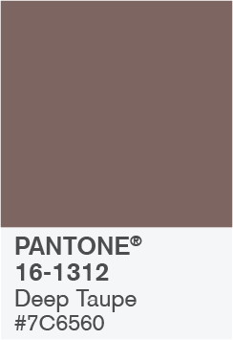


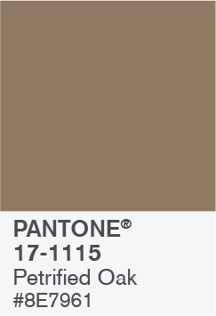
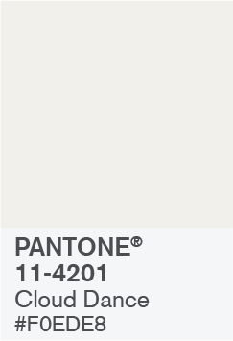
THE STAR OF THE SHOW

Slide 9

THE STAR OF THE SHOW
When you want a more elegant approach, the dynamic presence of PANTONE Very Peri shines as the star of the show in this palette of classics and neutrals whose understated stylishness conveys a message of timeless sophistication.

Slide 10
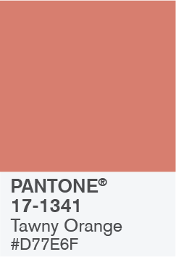
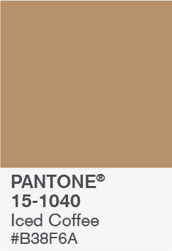

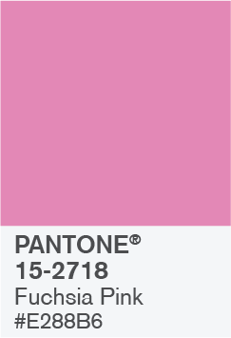



AMUSEMENTS

Slide 11
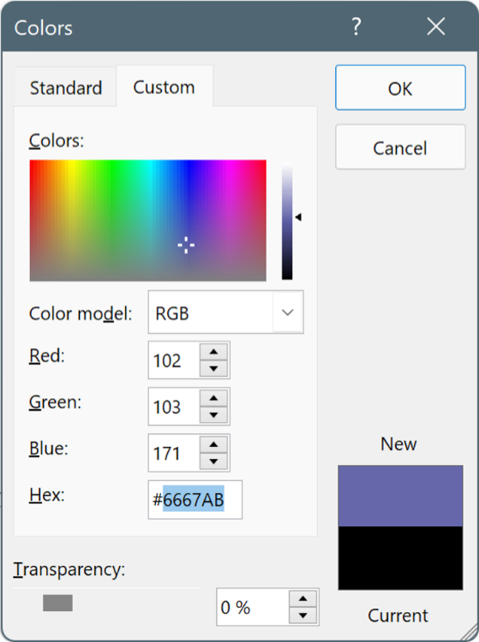
USE THESE COLORS IN ANY POWERPOINT PRESENTATION
Select a shape or text box border. When you do that, the Shape Format tab appears.
On the Shape Format tab, select Shape Fill > More Fill Colors.
In the Colors box, select the Custom tab.
Enter the Hex value of the color you want to use.
Tip: To change multiple shapes or text boxes, click the first shape or text box, and then press and hold Ctrl while you click the other shapes or text boxes.

